Slide 1

GE100 - Application of Information and Communication Technologies
Lec # 5: MS OFFICE
Detail overview of Office Suite Applications
Instructor: Alina Maryum

Slide 2
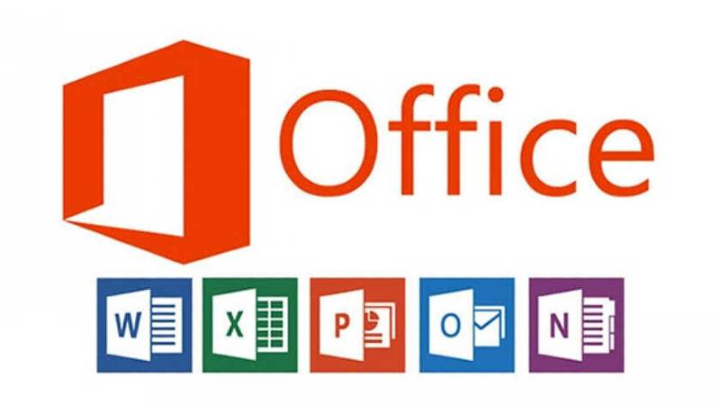
Ms office
Microsoft Office was launched by Microsoft in 1989 as a suite of productivity software primarily used for business, educational, and personal tasks. The original suite included MS Word, MS Excel, and MS PowerPoint, each designed for specific tasks—word processing, spreadsheets, and presentations, respectively.
Over the years, MS Office has evolved to include a variety of applications (like MS Access, Outlook, and Publisher), making it the most widely used productivity suite globally. MS Office’s constant updates introduced new features, improving ease of use, functionality, and collaboration capabilities.

Slide 3
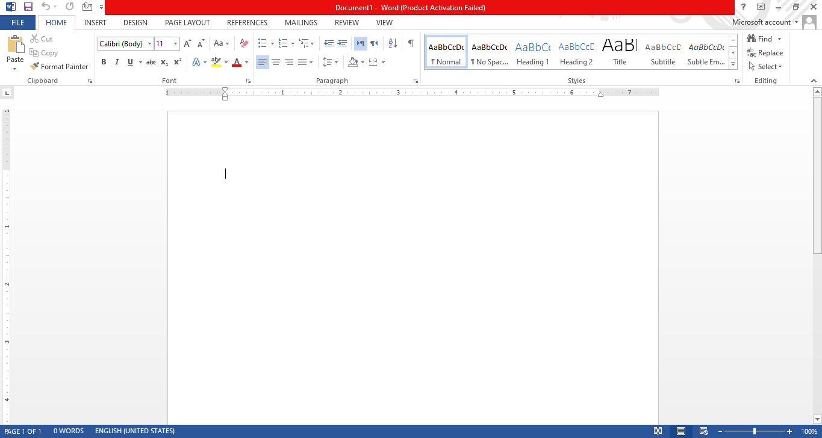
2. Introduction to MS Word
Microsoft Word is a powerful word processing application within the MS Office suite, designed for creating and formatting text-based documents.
It allows users to write, edit, and format various document types like letters, resumes, research papers, reports, and more.
MS Word offers a range of tools for text manipulation, layout design, and multimedia integration, making it versatile for professional and personal use.

Slide 4
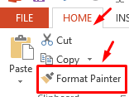
3. Key Terminologies and Features in MS Word
1. Format Painter
Description: Format Painter allows users to copy the formatting of selected text or objects and apply it to other text or objects within the document.
Use Case: It’s useful for quickly applying consistent formatting throughout a document without manually adjusting each section.
Shortcut: Ctrl + Shift + C to copy formatting, and Ctrl + Shift + V to apply.

Slide 5
3. Key Terminologies and Features in MS Word
2. Document Views
Overview: MS Word offers multiple views to display a document differently based on the task:
Print Layout: Default view for creating and editing documents as they appear on the printed page.
Web Layout: View for seeing the document as it would appear as a webpage.
Outline View: Organizes the document structure into headings, making it easier to manage large documents.
Draft View: A simplified view to focus on text editing without layout elements.
Shortcut for Print Layout: Alt + W then P.

Slide 6
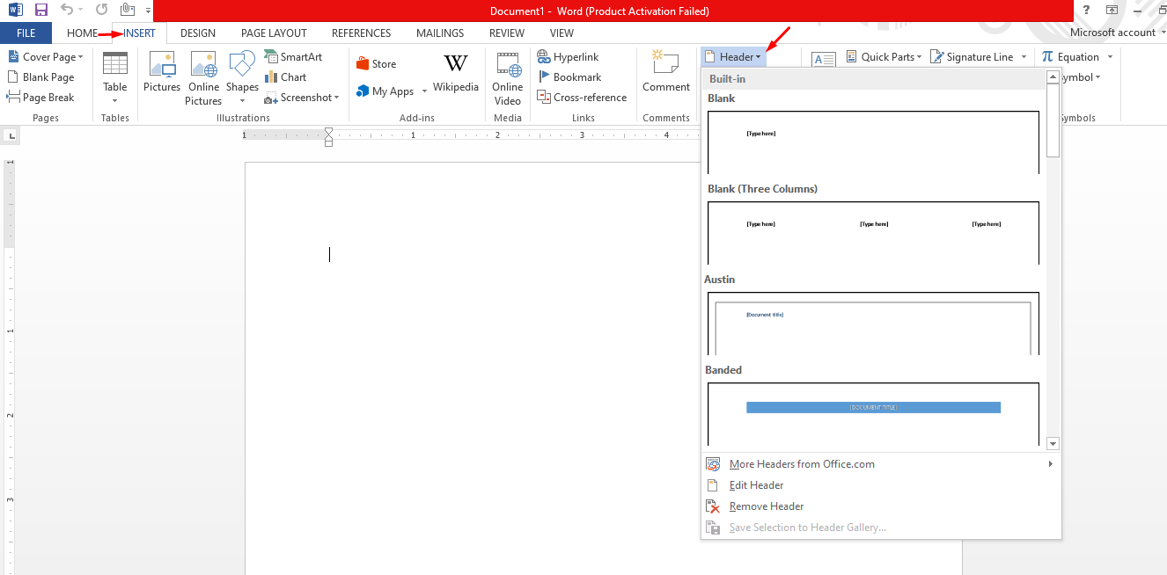
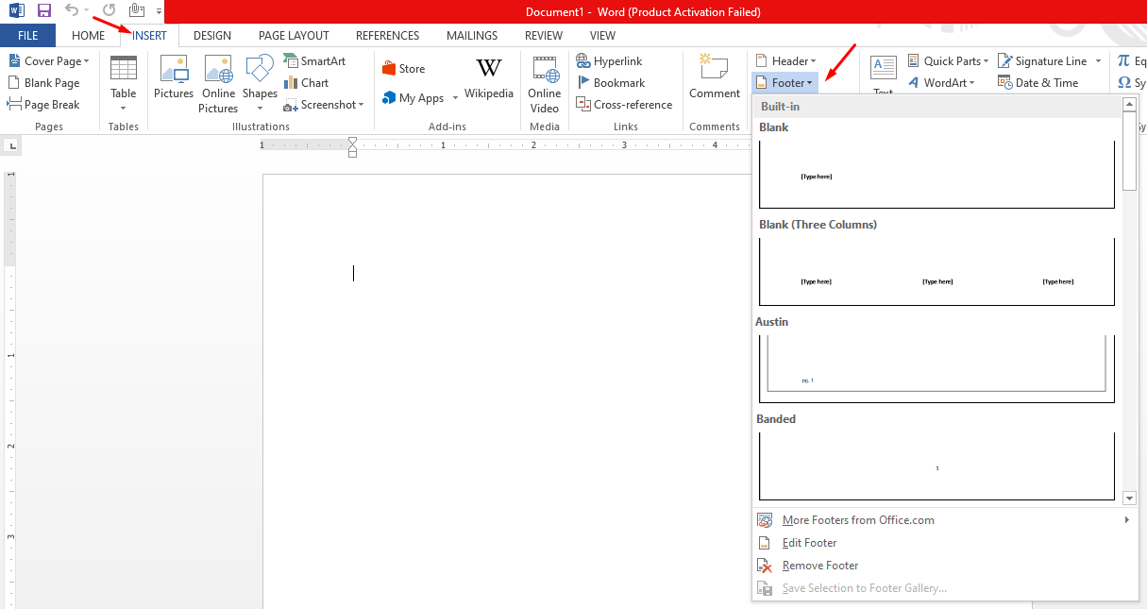
3. Key Terminologies and Features in MS Word
3. Headers and Footers
Description: Headers appear at the top, and footers at the bottom of each page. They are used to include elements like page numbers, document title, author name, or date.
Use Case: Essential for professional documents to maintain consistency and make navigation easier.
Shortcut: Alt + N, then H for Header and Alt + N, then O for Footer.

Slide 7
3. Key Terminologies and Features in MS Word
3. Headers and Footers
Description: Headers appear at the top, and footers at the bottom of each page. They are used to include elements like page numbers, document title, author name, or date.
Use Case: Essential for professional documents to maintain consistency and make navigation easier.
Shortcut: Alt + N, then H for Header and Alt + N, then O for Footer.

Slide 8
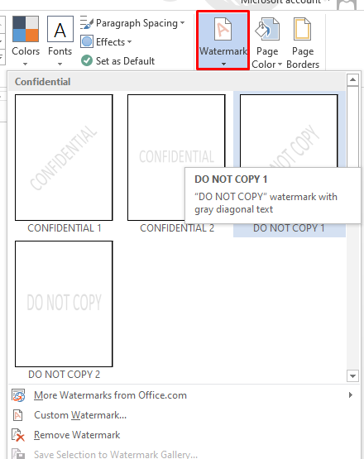
3. Key Terminologies and Features in MS Word
4. Watermark
Description: A semi-transparent text or image displayed behind the document content, often used to label documents as "Confidential" or "Draft."
Use Case: Helps identify the status or nature of a document at a glance.
Shortcut: Located in the Design tab, accessible with Alt + G then W

Slide 9
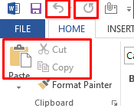
3. Key Terminologies and Features in MS Word
5. Undo and Redo
Undo: Reverts the last action performed in the document.
Shortcut: Ctrl + Z
Redo: Repeats the last undone action.
Shortcut: Ctrl + Y
6. Copy, Paste, and Cut
Copy: Duplicates selected text or object to the clipboard.
Shortcut: Ctrl + C
Paste: Inserts content from the clipboard to the chosen location in the document.
Shortcut: Ctrl + V
Cut: Removes selected text or objects and copies them to the clipboard.
Shortcut: Ctrl + X

Slide 10
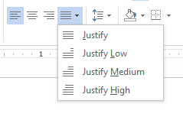
3. Key Terminologies and Features in MS Word
7. Text Alignment
Description: Determines the positioning of text within the document, offering options like left, right, center, and justify.
Use Case: Useful for formatting paragraphs and organizing document layout.
Shortcuts:
Align Left: Ctrl + L
Align Center: Ctrl + E
Align Right: Ctrl + R
Justify: Ctrl + J

Slide 11
3. Key Terminologies and Features in MS Word
Footnotes and Endnotes in MS Word
Footnotes and Endnotes are tools used to provide additional information, explanations, or citations in a document without interrupting the main body of text. They’re especially useful in academic, legal, and technical writing where referencing or elaboration is required.

Slide 12
3. Key Terminologies and Features in MS Word
1. Footnotes
Location: Appears at the bottom of the same page where the reference number is inserted.
Purpose: Used for brief explanations, additional information, or citation of sources directly related to a specific part of the text.
Example Use Case:
In a research paper, a statement might need a source citation immediately accessible to the reader. Adding a footnote provides a quick reference to the source without moving away from the main content.
How to Insert a Footnote:
Step 1: Place the cursor at the point in the text where you want to insert the footnote.
Step 2: Go to the References tab.
Step 3: Click on Insert Footnote (shortcut: Alt + S, then F).
Step 4: Type the footnote text at the bottom of the page.
Formatting Options for Footnotes:
MS Word automatically numbers footnotes sequentially (e.g., 1, 2, 3) or with Roman numerals (i, ii, iii).
You can customize the numbering style by right-clicking the footnote and selecting Footnote Options.
MS Word also allows you to change the font, size, and style of the footnote text independently from the main document text.

Slide 13
3. Key Terminologies and Features in MS Word
2. Endnotes
Location: Appears at the end of the document or section.
Purpose: Often used to provide detailed explanations, lengthy citations, or additional sources that might distract from the document flow if placed within the main text.
Example Use Case:
In a thesis or book, where a reader may not need to reference sources frequently, endnotes can be used to consolidate all references in one place, making the main text cleaner.
How to Insert an Endnote:
Step 1: Place the cursor where you want to insert the endnote reference.
Step 2: Go to the References tab.
Step 3: Click on Insert Endnote.
Step 4: Type the endnote content at the end of the document or designated section.
Formatting Options for Endnotes:
Endnotes also support different numbering styles (e.g., Arabic numerals, Roman numerals).
You can choose to restart numbering for each chapter or section.
Custom styles and font options are available to format endnotes separately from the document text.

Slide 14
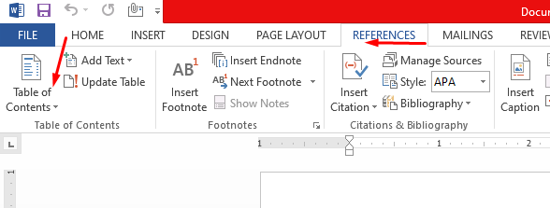
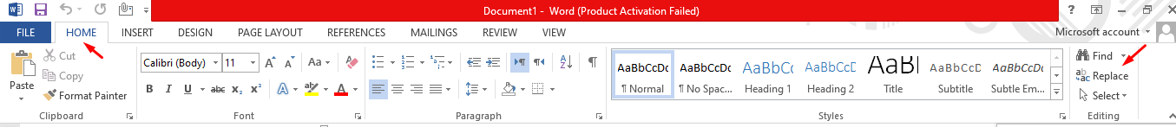
3. Key Terminologies and Features in MS Word
Table of Contents
Description: An automatic summary of headings and subheadings within the document, allowing for easy navigation.
Use Case: Essential for organizing and navigating long documents like books, reports, or research papers.
Shortcut: Accessible in the References tab (Alt + S then T).
Find and Replace
Find: Locates specific words or phrases within the document.
Replace: Allows substitution of one word or phrase with another throughout the document.
Shortcut:
Find: Ctrl + F
Replace: Ctrl + H

Slide 15
3. Key Terminologies and Features in MS Word
Page Setup Options
Margins: Defines the space between text and the edge of the page.
Orientation: Sets the page layout to portrait or landscape.
Columns: Splits text into multiple columns for a magazine or newsletter layout.
Shortcut for Page Setup: Located in the Layout tab (Alt + P then M for Margins).
Page Breaks and Section Breaks
Page Break: Moves content to the next page.
Section Break: Divides a document into sections, allowing for different formatting in each section.
Shortcut for Page Break: Ctrl + Enter
SmartArt Graphics
Description: Pre-designed graphics for displaying information visually, such as flowcharts and organizational charts.
Shortcut: Located under the Insert tab.

Slide 16
2. Introduction to MS PowerPoint
Microsoft PowerPoint is a presentation software used to create slideshows composed of text, images, charts, animations, and multimedia. It's widely used in business, education, and personal presentations to communicate ideas effectively.

Slide 17
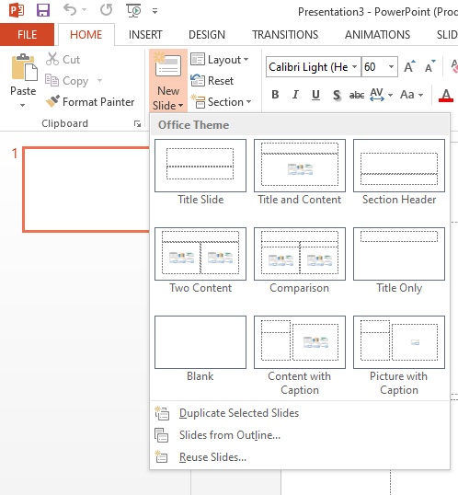
Slide
1. Slide
Definition: A single page within a PowerPoint presentation where content is added.
Types: Title slide, content slide, section header, and blank slide.
Shortcut: Ctrl + M to insert a new slide.

Slide 18
Slide Layout
Definition: Predefined arrangement of text boxes and content placeholders within a slide.
Use Case: PowerPoint offers various layouts like Title Slide, Two Content, Comparison, and Picture with Caption to structure content.
Shortcut: Ctrl + Shift + L opens the layout options.
Notes Pane
Definition: A space at the bottom of each slide to add notes visible only to the presenter.
Use Case: Useful for adding additional points, reminders, or talking cues to guide the presenter without displaying them to the audience.

Slide 19
Slide Layout
Transition Effects
Definition: Visual effects applied when moving from one slide to another, such as Fade, Push, and Wipe.
Use Case: Transitions enhance the flow of the presentation, providing smooth transitions between ideas.
Shortcut: Select a slide and go to the Transitions tab.
Animations
Definition: Effects applied to individual elements within a slide, such as text boxes, images, and charts.
Types: Entrance, Emphasis, Exit, and Motion Paths.
Use Case: Animations highlight important points, making the presentation more engaging.
Shortcut: Alt + A to open the Animations tab.
Animation Pane
Definition: A tool within the Animations tab that provides a timeline of all animations on the slide.
Use Case: Allows fine-tuning of animation timing, order, and effects, giving full control over the animation sequence.
Access: Animations tab > Animation Pane.

Slide 20
Slides views
Presenter View/slideshow
Definition: A display mode that shows the current slide, next slide, notes, and a timer, helping presenters stay organized.
Use Case: Presenter View aids in delivering smooth presentations by providing a clear structure and cue for the presenter.
Shortcut: Start slideshow in Presenter View by pressing Alt + F5.
Slide Sorter View
Definition: A view that displays all slides as thumbnails, allowing for easy rearrangement and overview.
Use Case: Useful for managing the flow of the presentation, reordering slides, and spotting inconsistencies.
Shortcut: Alt + W, then I
Reading View
Definition: A full-screen view that shows the slides without switching to a full presentation mode.
Use Case: Ideal for reviewing slides with animations without using Presenter View or Slideshow View.
Shortcut: Alt + W, then D.
Slide Master
Definition: A master slide that controls the layout, fonts, colors, and effects for all slides in a presentation.
Use Case: Slide Master ensures consistency across slides, making it easy to apply changes to multiple slides at once.
Access: View tab > Slide Master.

Slide 21
MS excel
Microsoft Excel is a spreadsheet software used for data organization, calculation, and analysis. It's essential for tasks involving data tracking, statistical analysis, and graphical representation.

Slide 22
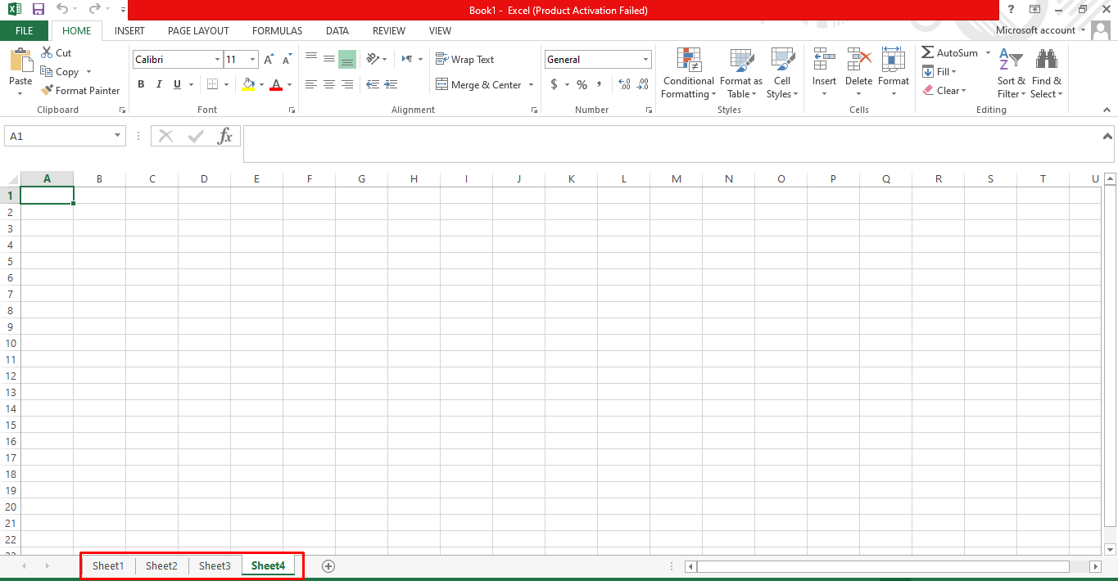
Key Terminologies
Workbook and Worksheet
Workbook: The entire Excel file containing multiple worksheets (or sheets).
Worksheet: A single spreadsheet within a workbook, organized into cells in rows and columns.
Shortcut: Ctrl + N to create a new workbook, Shift + F11 to add a new worksheet.

Slide 23
Key Terminologies
Cells, Rows, and Columns
Cell: The basic unit in a worksheet where data is entered, identified by a column letter and row number (e.g., A1).
Row: Horizontal line of cells, identified by a number.
Column: Vertical line of cells, identified by a letter.
Shortcut: Ctrl + Space to select a column, Shift + Space to select a row
Formula and Functions
Formula: A custom calculation created by the user starting with an equals sign (e.g., =A1+B1).
Functions: Predefined calculations like SUM, AVERAGE
Conditional Formatting
Definition: Changes the appearance of cells based on specific conditions, like highlighting cells above a certain value.
Use Case: Useful for emphasizing important data, such as highlighting low inventory.
Shortcut: Alt + H, then L for Conditional Formatting.

Slide 24
Key Terminologies
Pivot Table
Definition: A tool for summarizing and analyzing large datasets by grouping data and creating reports.
Use Case: Used to calculate, summarize, and present data, such as sales figures or inventory.
Shortcut: Alt + N, then V for inserting a Pivot Table.

Slide 25
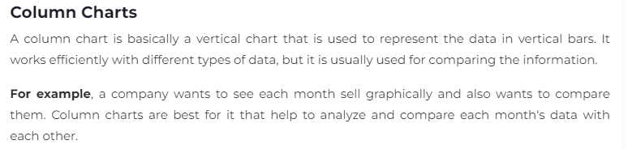
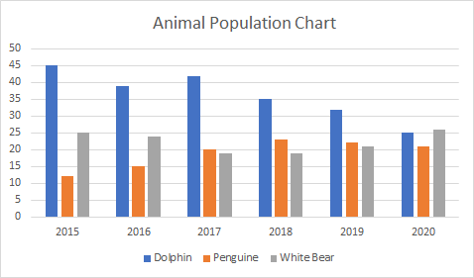
Key Terminologies
Charts
Definition: Visual representations of data, including bar charts, line graphs, pie charts, etc.
Use Case: Useful for interpreting data trends and patterns visually.
Shortcut: Alt + F1 to create a chart, or F11 for a chart in a new sheet.

Slide 26
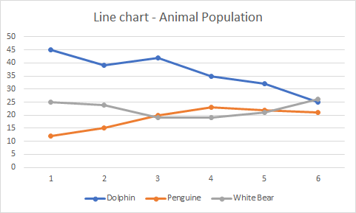
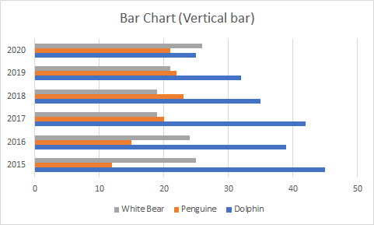
Line Chart
Line charts are most useful for showing trends. Using this chart, you can easily analyze the ups and downs in your data over time. In this chart, data points are connected with lines.
For example, a company wants to analyze the sell of products for the last five years graphically. Additionally, it also wants to analyze the ups and downs of each year product sell.
Bar chart
Bar charts are horizontal bars that work like column charts. Unlike column charts, Bar charts are horizontally plotted. Or you can say that bar charts and column charts are just opposite to each other.
For example, a company uses the bar chart to analyze the data through vertical bars to represent the data graphically. You can see as well as compare the values to each other, respective to data.

Slide 27
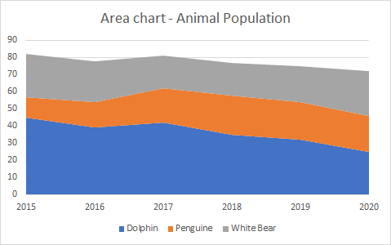
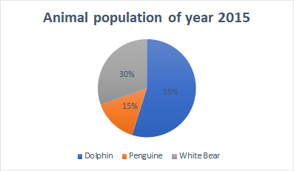
Area chart
Area charts are just like line charts. Unlike the line charts, gaps are filled with color in area charts. Area charts are easy to analyze the growth in business as its shows ups and downs through line.
Pie chart
A pie chart is a rounded shape graph that is divided into slices of pie. Using this chart, you can easily analyze data that is divided into slices. It makes the data easy to compare the proportion.
Pie charts make it easy to analyze which values make up the percentage of whole. Pie chart is also known as Doughnut chart. Excel offers 2D and 3D pie charts.

Slide 28
Chart Type | When to choose this chart
1. | Column Chart | Use the column chart when you want to compare the multiple values across a few categories. The values are shown through vertical bars.
2. | Line Chart | Choose this chart when you want to show the treads (ups and downs) over a period of time, like for months or years.
3. | Bar Chart | Like the column chart, use this chart to compare the values across a few categories. In this chart, values are displayed in the horizontal bar.
4. | Area chart | Area chart has the same pattern as the line chart. This chart is best to use for indicating a change among different sets.
5. | Pie or Doughnut chart | Pie chart is best to use when you want to quantify the values and show them as percentage.

Slide 29
MS Access
Microsoft Access is a database management tool used for creating, managing, and manipulating data in a structured way. It's ideal for data storage, reporting, and analysis in businesses and organizations with complex datasets.

Slide 30
Overview
1. Database
Definition: A structured set of data managed within Access, often saved as .accdb files.
Components: Databases in Access include tables, queries, forms, and reports.

Slide 31
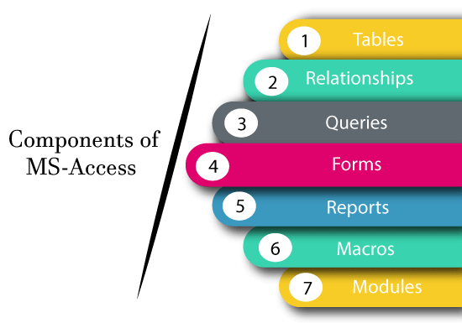

Slide 32
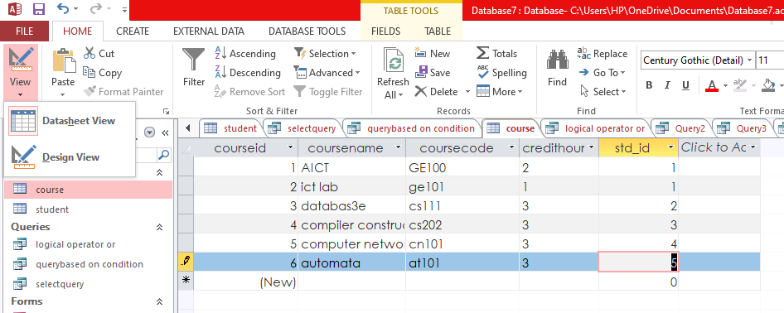
Shortcut for Table Views: Ctrl + F2 to toggle between Datasheet and Design View.
Table: In MS Access, a table is a structured set of data organized into rows and columns. Each row is a record (or tuple), and each column is a field that stores a particular type of data.
Table Views:
Datasheet View: A spreadsheet-like view where you can enter, edit, and delete data directly in a table.
Design View: A view for defining the structure of the table, setting field names, data types, properties, and designating primary keys.

Slide 33
MS Access
2. Fields and Tuples
Field: Represents a column in a table, holding specific data types (e.g., Text, Number, Date/Time) and representing an attribute of the entity. Each field must have a unique name within the table.
Tuple (Record): Each row in a table is a record or tuple, containing a unique set of data across all fields for a specific entity (e.g., one customer’s details).

Slide 34
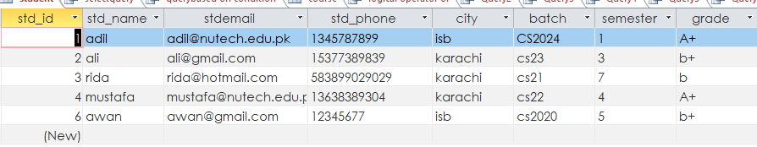
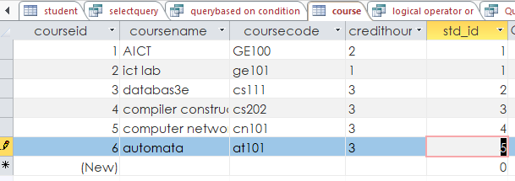
Primary Key and Foreign Key
Primary Key: A field or combination of fields in a table that uniquely identifies each record. It ensures no duplicate data within that field. Examples include studentID or courseID.
Foreign Key: A field in one table that links to the primary key in another table, establishing a relationship between tables. For instance, a studentID in an Course table serves as a foreign key, linking back to the Students table’s primary key.
Foreign key
Primary key
Primary key

Slide 35
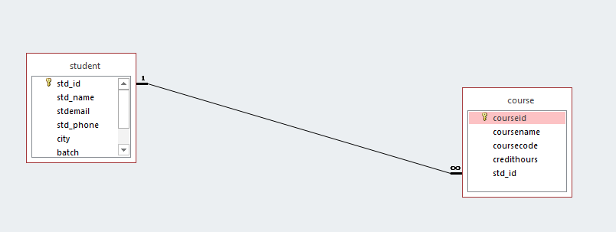
Relationships and Referential Integrity
Relationships: Define how tables are connected through primary and foreign keys. Access supports three main types:
One-to-One: Each record in one table corresponds to only one record in another table.
One-to-Many: Each record in one table relates to multiple records in another. Commonly used for linking primary and foreign keys.
Many-to-Many: Each record in one table can relate to multiple records in another and vice versa. This requires an intermediate (junction) table.
Referential Integrity: Ensures the accuracy and consistency of data within relationships. For example, referential integrity prevents deletion of a record in the primary table if related records exist in a linked table.

Slide 36
Cascade Update and Cascade Delete
Cascade Update: When enabled, any update to the primary key in the main table automatically updates all linked foreign keys in related tables.
Cascade Delete: When enabled, deleting a record in the main table will also delete all related records in the linked table(s). It’s useful for maintaining data integrity but must be used cautiously to avoid accidental data loss.

Slide 37
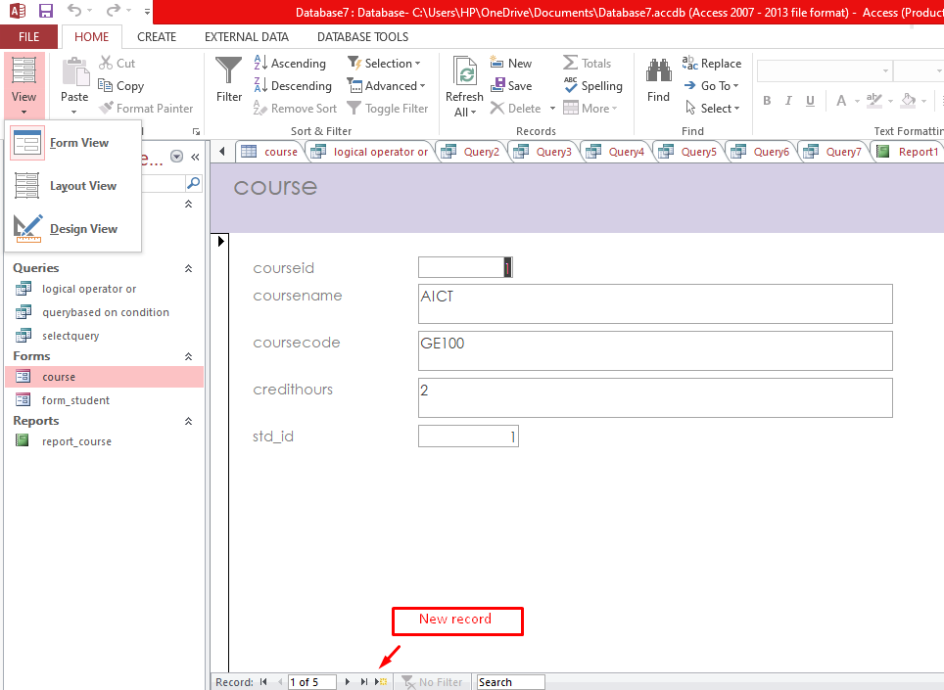
Forms
Form: A customizable interface for data entry, editing, and viewing in a user-friendly format. Forms in Access can be designed to control what data users see and can interact with.
Use Case: Forms are beneficial for users who need to interact with the database but may not be familiar with tables or queries. For instance, a form for entering customer information may include only the necessary fields for easy and error-free data entry.
Access Forms: Create tab > Form or Form Design for more customization.

Slide 38

Queries and Query Views
Query: A query is a request to extract, update, delete, or add data in one or more tables based on specified criteria.
Types of Queries:
Select Query: Extracts specific data from tables based on set criteria.
Update Query: Modifies selected records.
Delete Query: Removes records that meet certain conditions.
Append Query: Adds records to another table
Query Views:
Datasheet View: Displays query results in a table-like format for easy review.
SQL View: Allows direct input of SQL (Structured Query Language) code to define the query.
Design View: Graphical interface for creating queries using tables, fields, and criteria without directly writing SQL.

Slide 39





B. Select Records Based on a Condition
This query filters records that meet certain conditions.
Example: Retrieve all customers from the Customers table where the City is “New York”.
1. Select Queries
A. Select All Records from a Table
This query retrieves all records from a specified table.
Example: Retrieve all records from the Customers table.
Delete Queries
Delete queries remove records based on specified conditions.
A. Delete All Records from a Table
This query deletes all records in a table.
Example: Delete all records from the ArchivedOrders table.
2. Update Queries
Update queries modify data in one or more records based on specified conditions.
A. Update a Specific Field for All Records
This query updates a single field for all records.
Example: Increase the Price of all products in the Products table by 10%.
B. Delete Records Based on a Condition
This query removes only records that meet certain criteria.
Example: Delete all customers from the Customers table whose Status is “Inactive.”
Explanation: This query multiplies the Price by 1.10, updating all records with a 10% price increase.

